Slide 1

Reinforcement Learning based Fine-tuning
Sourish Dasgupta
Associate Professor, DAU, Gandhinagar
https://daiict.ac.in/faculty/sourish-dasgupta

Slide 2
Why we need to go beyond Instruction-based SFT
Limitation | Cause | What can happen
Single-reference loss – cross-entropy scores only one “gold” answer | Teacher-forcing treats any divergence from that answer as error, even if several answers are equally good | Repetition or generic answers; no reward for richer explanations
Length bias & brevity reward | Cross-entropy normalises by tokens, so shorter replies get less loss and dominate training | SFT models often produce terse, under-informative answers
Hard-coded style / tone | SFT bakes a fixed style that mirrors the dataset; changing tone means collecting new triples | Model can’t easily be made more formal, shorter, etc.
Limited long-horizon control | Token-level CE sees only one turn; multi-turn goals receive no direct signal ﻿ | Incoherent or contradictory multi-turn chats

Slide 3
Reinforcement Learning: Building Blocks

Slide 4
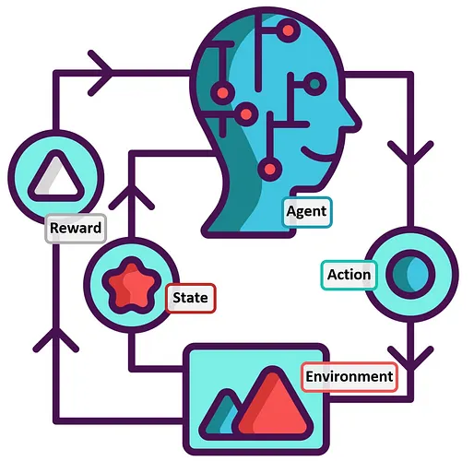
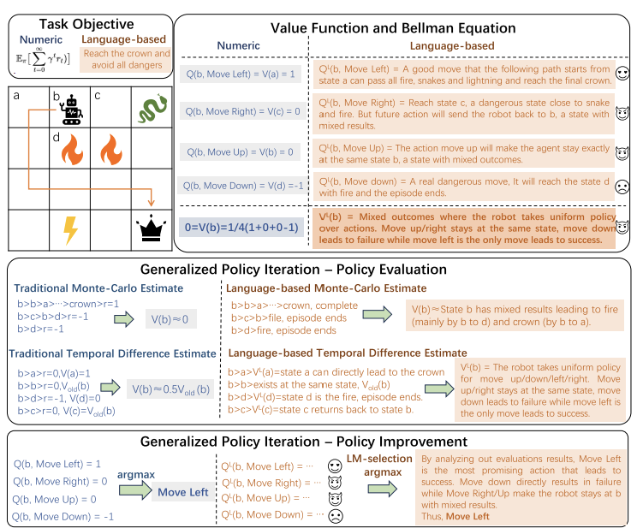
The Game of “Treasure Hunt”

Slide 5
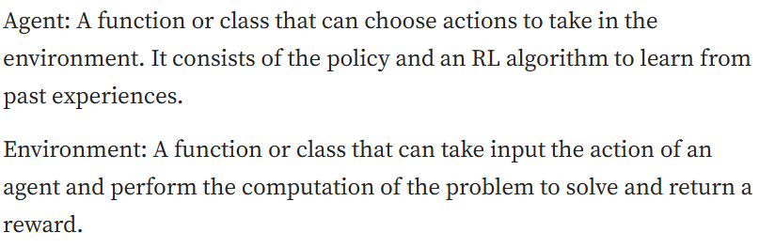
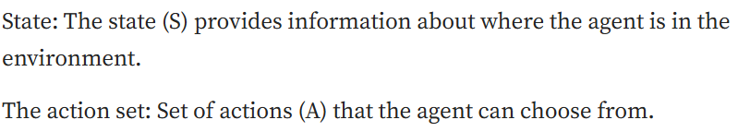
Agent plans in an Environment (good/bad/ugly)

Slide 6
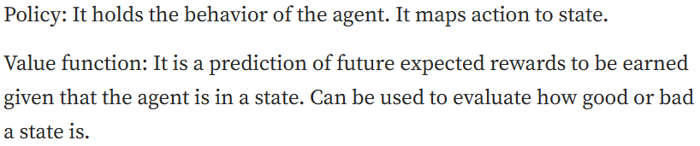
In each state Agent has a policy (what to do)
May not be the best (optimal) → that’s the goal

Slide 7
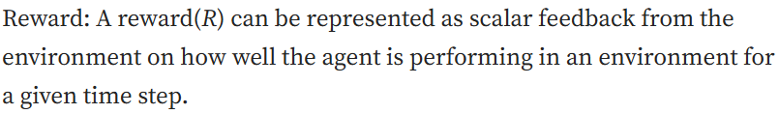
Agent’s action has a consequence (Reward)

Slide 8
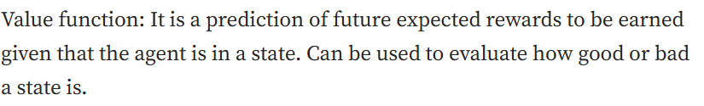
Because of rewards Agent can be in good/bad/ugly state (Value)

Slide 9
(Finite) Markov Decision Process

Slide 10
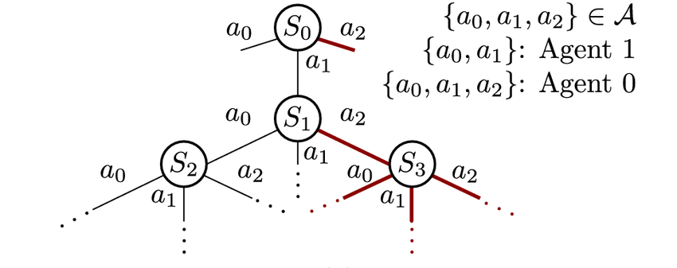
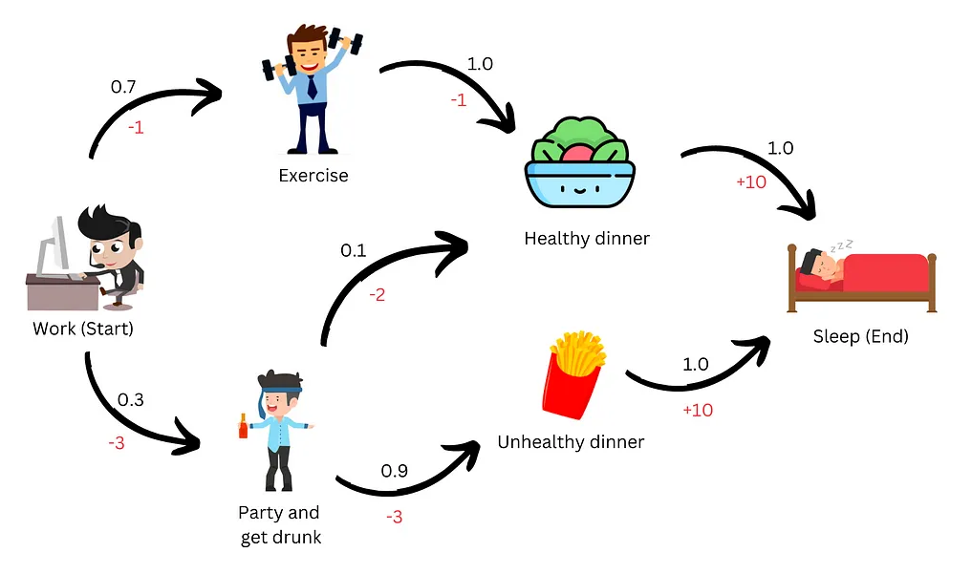
An example Finite Markov Decision Process (MDP)

Slide 11
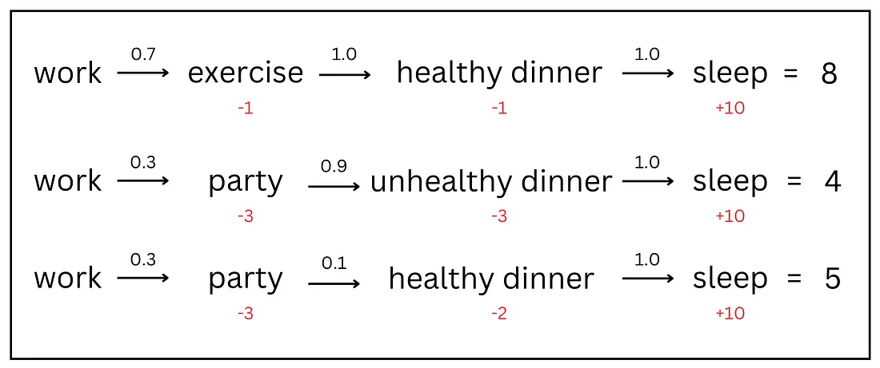
Markov Processes

Slide 12
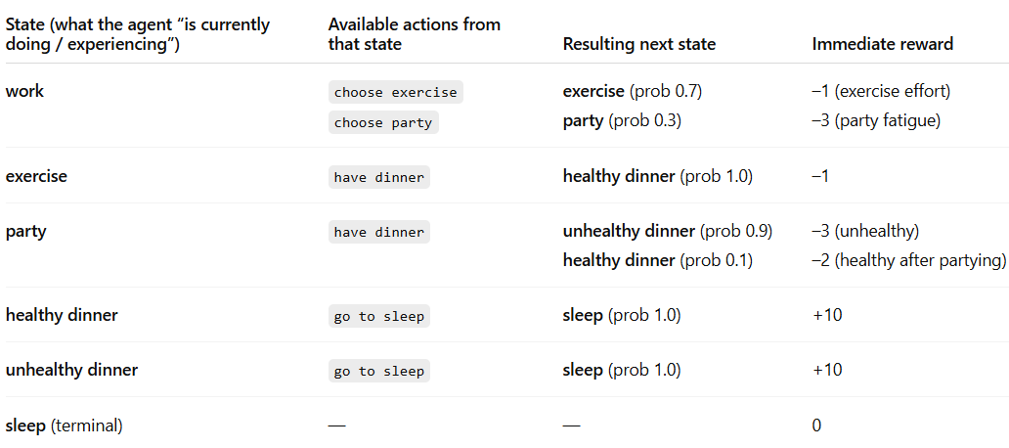

Why “Markov”?

Slide 13
What happens because of MDP Assumption

Slide 14


Environment provides “Reward” when Agent arrives at s’
Can be deterministic as well

Slide 15
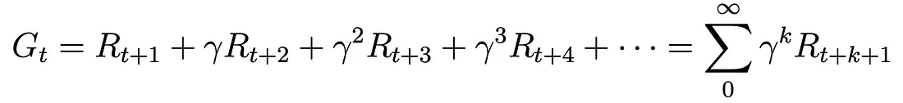
Agent needs to maximize “Return”?

Slide 16

How good is a state = How good is the “Expected Return”?

Slide 17

What “Markov” means is how good is the next state
Bellman Equation

Slide 18

How good is a state = How good is the “Expected Return”?

Slide 19

What would be the state-to-action mapping (Policy)?
Policy → may not be optimal (yet)

Slide 20
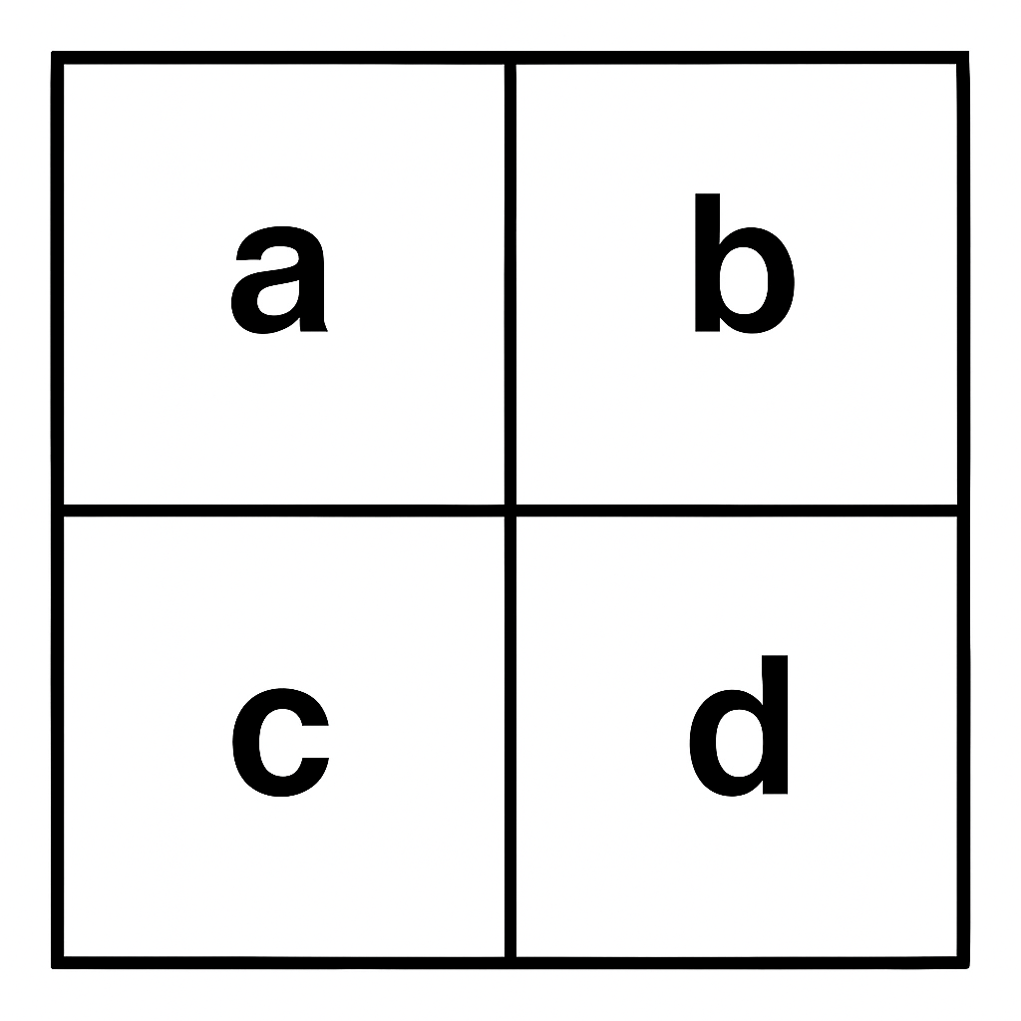
What exactly is a Policy?
state ↓ / action → | Up | Down | Left | Right
a (start) | 0.00 | 0.00 | 1.00 | 0.00
b | 0.00 | 0.70 | 0.30 | 0.00
c | 1.00 | 0.00 | 0.00 | 0.00
d (goal) | 0.25 | 0.25 | 0.25 | 0.25
It’s essentially a probability transition table (that might need fixing)

Slide 21
Reinforcement Learning

Slide 22
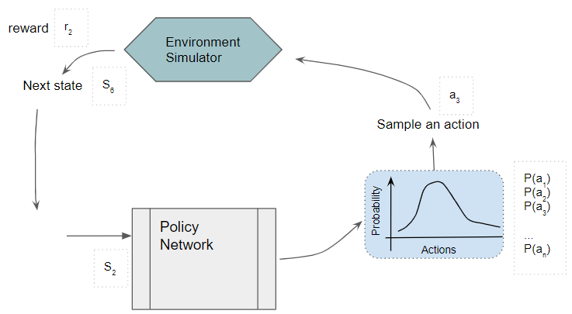
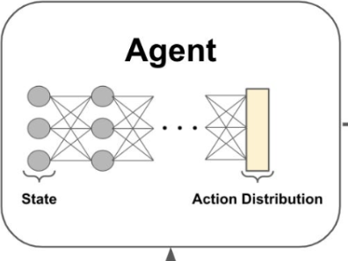
What is Policy Update for an LLM (in the context of RL-tuning)?
needs fixing

Slide 23

What would be the Optimal Policy?
Optimal Policy → target
Model has to learn (Value learning)
Bit tedious!

Slide 24
Easier way: How good is an Action from a specific State (Q-State)?

Slide 25

Easier way: What would be the Optimal Policy?
Optimal Policy → target
Model has to learn (Q-Learning)
Easy!!

Slide 26
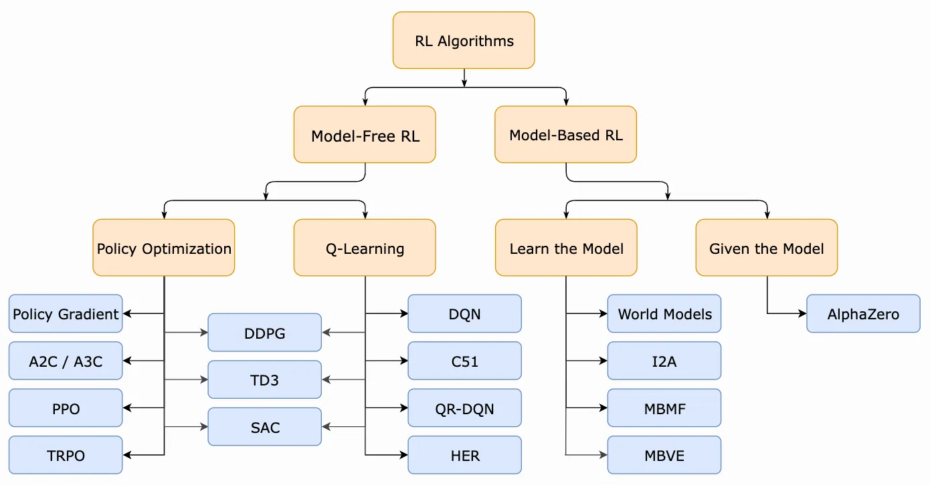


Reinforcement Learning Algorithms (Policy Optimization)

Slide 27

Reinforcement Learning Algorithms (Policy Optimization)

Slide 28






Reinforcement Learning Algorithms (Policy Optimization)

Slide 29
Reinforcement Learning Algorithms
Source: https://spinningup.openai.com/en/latest/spinningup/rl_intro2.html

Slide 30
RL in NLP

Slide 31
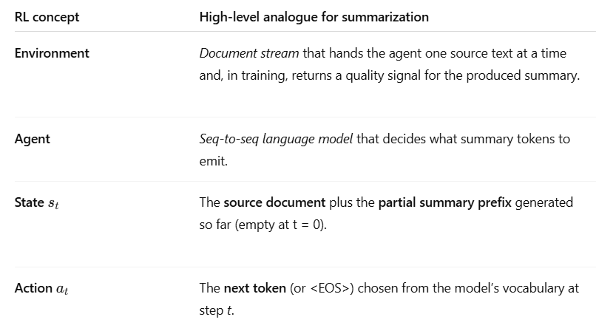
Framing Summarization as Policy-Update Problem

Slide 32
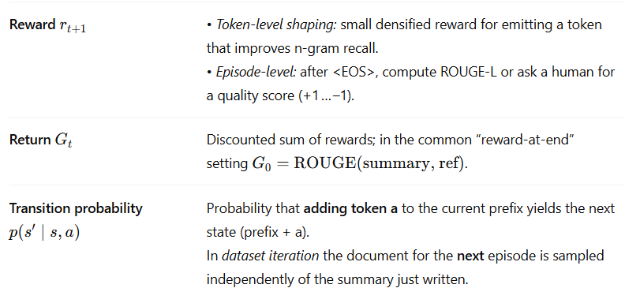
Framing Summarization as Policy-Update Problem

Slide 33
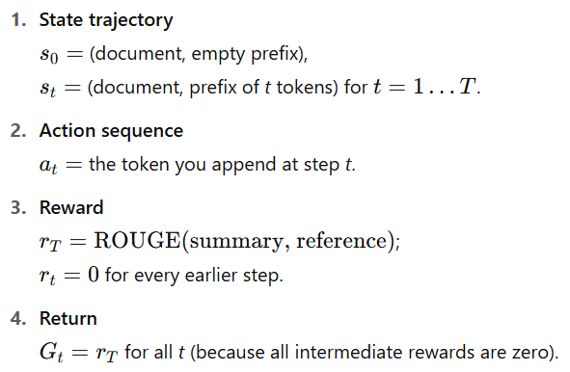
However, something is different …

Slide 34
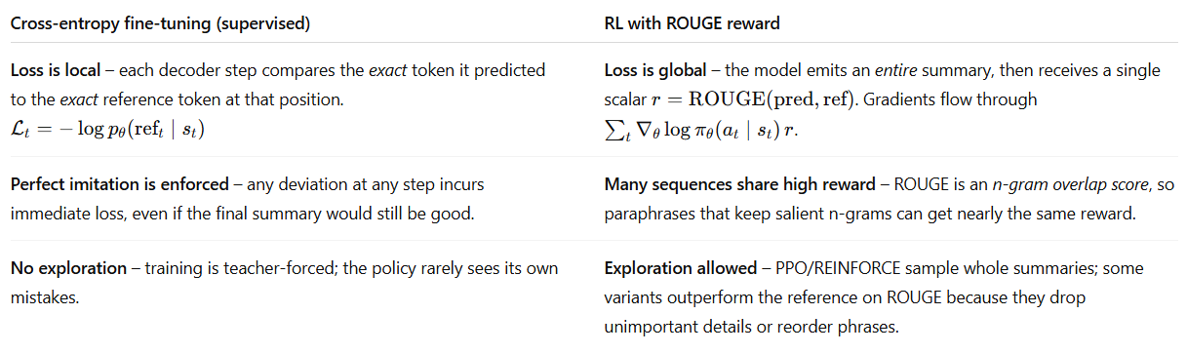
Then why not just call it Supervised Fine-tuning?

Slide 35
Then why not just call it Supervised Fine-tuning?
“NASA announced today that its Perseverance rover discovered possible signs of ancient microbial life on Mars.”
Candidate summary | Matches n-grams? | ROUGE-1 / ROUGE-2
“NASA’s Perseverance rover found hints of ancient life on Mars, the agency revealed.” | keeps “Perseverance rover … ancient life on Mars” | 0.81 / 0.63
“Perseverance discovers fossils.” | almost no n-gram overlap | 0.14 / 0.05
The sequence and phrase is different yet the final Return is high

Slide 36
Key Takeaways: RL vs Supervised Fine-tuning
Training style | Interaction loop | Policy update
Supervised fine-tuning (MLE) | Environment → document → Agent Agent outputs full summary (greedy). Loss = negative log-likelihood vs. gold summary. | Back-prop on cross-entropy; no explicit reward needed.
RL fine-tuning (e.g., PPO with 🤗 TRL) | Environment → document. Agent samples summary tokens step-by-step. After <EOS> a reward function (ROUGE / human) returns r. | PPO/DPO/ILQL move the policy toward summaries with higher rewards; Value head estimates expected Return from partial prefixes.

Slide 37
(Offline) Policy-update based RL in NLP

Slide 38
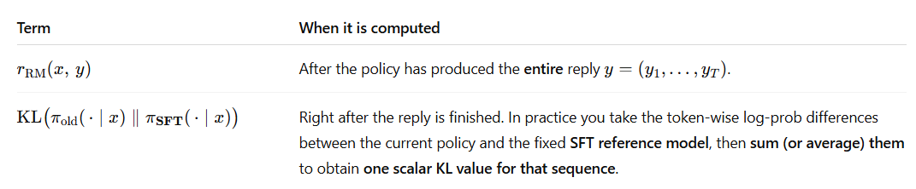
Return (= Reward) after Response is completed

Slide 39

Example: Return for Summarization Task

Slide 40







Policy Update needs loves intermediate incentive for training
Problem: At the end!

Slide 41
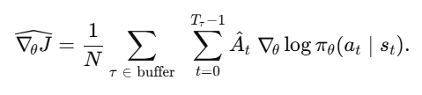



Policy Update in the context of PPO

Slide 42
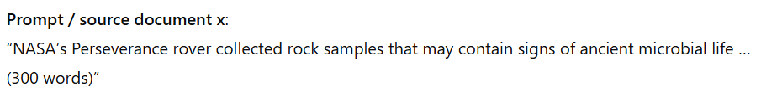
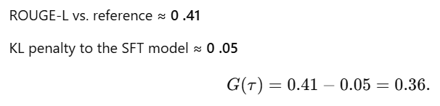
How Advantage Function works …

Slide 43
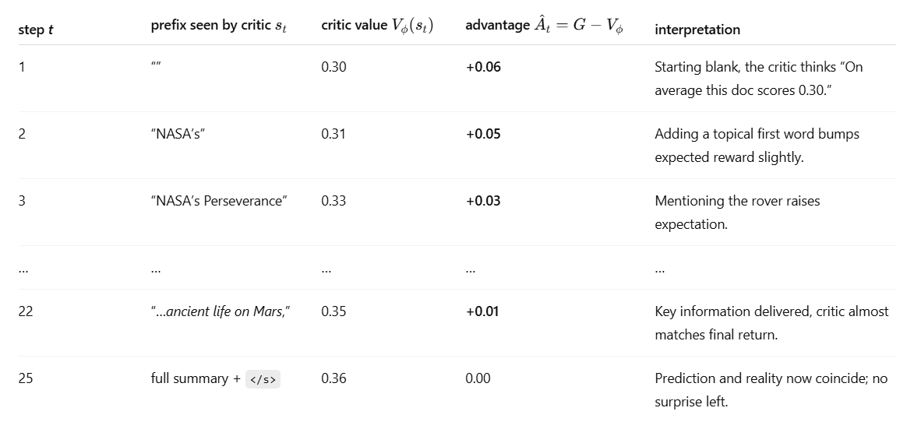
How Advantage Function (i.e., Critic) helps the Actor
by step 22 it’s 95 % sure, so only a tiny +0.01 “bonus” remains.

Slide 44



Extracting Importance Ratio out
Importance Ratio (Store previous checkpoints → Offline Policy)
Gradient = 0 (because old is frozen)

Slide 45

But the Critic is also not a great teacher (yet)!

Slide 46
PPO kicks in!

Slide 47



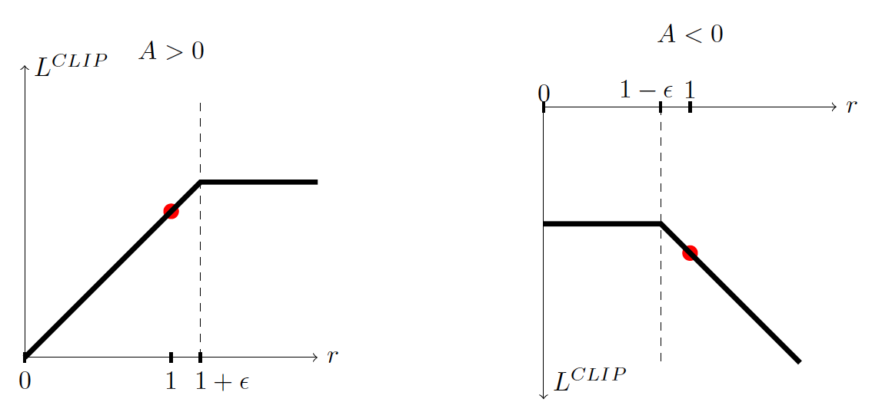

PPO is all about regulating the Importance Ratio
Small shift
Large shift

Slide 48

The final Aggregate Loss
(H) For Exploration

Slide 49
Why we need to go beyond Instruction-based SFT
Limitation | Cause | What can happen
Single-reference loss – cross-entropy scores only one “gold” answer | Teacher-forcing treats any divergence from that answer as error, even if several answers are equally good | Repetition or generic answers; no reward for richer explanations
Length bias & brevity reward | Cross-entropy normalises by tokens, so shorter replies get less loss and dominate training | SFT models often produce terse, under-informative answers
Hard-coded style / tone | SFT bakes a fixed style that mirrors the dataset; changing tone means collecting new triples | Model can’t easily be made more formal, shorter, etc.
Limited long-horizon control | Token-level CE sees only one turn; multi-turn goals receive no direct signal ﻿ | Incoherent or contradictory multi-turn chats

Slide 50
User Preference-based Fine-tuning → RLHF (next class)

